Slide 1
Intermediate code generation
Dr G sudha Sadasivam

Slide 2
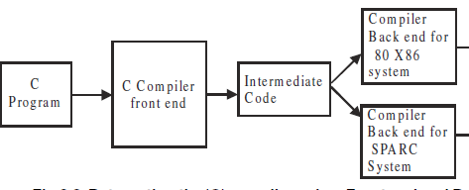
Need for ICG
It facilitates machine independent code optimization. ICG by the front end can be optimized by using several techniques.
It is easy to re-target the compiler to generate code for newer and different processors.
80x86 system
SPARC system

Slide 3
Intermediate codes
Postfix notation: no need for parenthesis
operand 1 operand2 operator
eg: a b +
Abstract syntax tree
Three address code

Slide 4
postfix
Ex1: x = c ? a : b
x c a b : ? =
Ex2:
if (f < 6)
z = p / q;
else if ( f == 6)
z=p*q;
else
z=p-q
Stack is used for evaluation
f 6 < z p q / = f 6 == z p q * = z p q - = : ? : ?
I jump
e I jeqz
e1 e2 I jlt

Slide 5
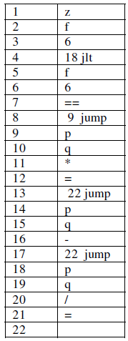
Advantages:
It eliminates the need for having parenthesis and has an unambiguous order of evaluation
It is reasonably easy to generate postfix code from the input source pro gram.
It is compact in terms of storage for the instructions.
Disadvantages
does not lend itself to be effectively for optimization.
This notation is ineffective for target code generation.
z f 6 < p q / f 6 == p q * p q - : ? : ? =

Slide 6
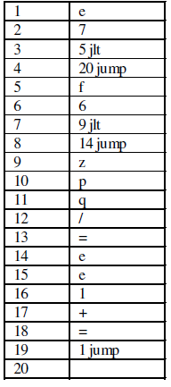
while (e < 7)
{
if (f < 6)
z = p/q;
else
e = e+1;
}
false

Slide 7
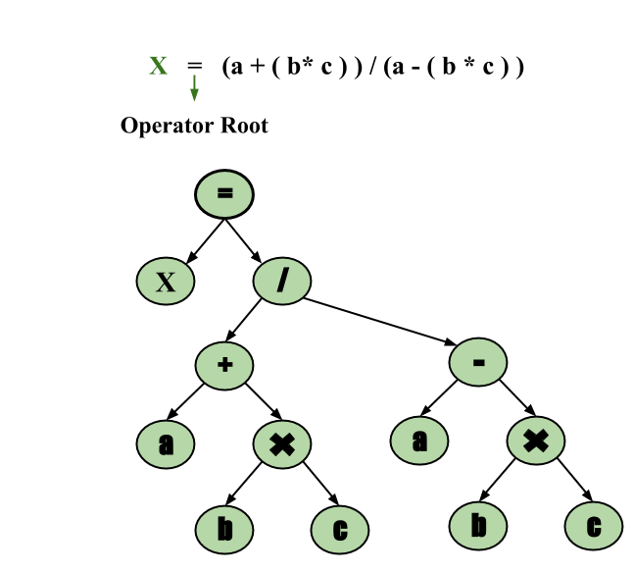
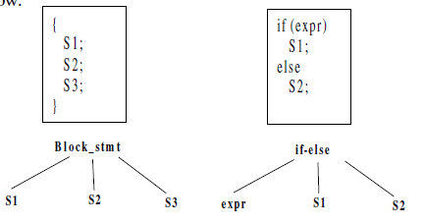
AST
Condensed form of parse tree

Slide 8
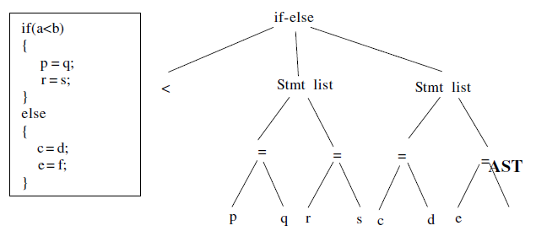
a
b
f

Slide 9
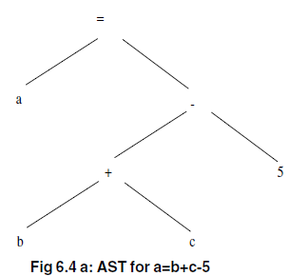
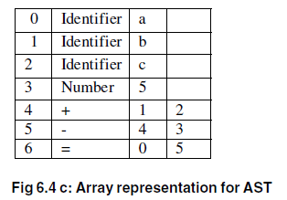
op
operand1
operand2
=
-
a
-
-
+
-
5
-
-
b
-
-
c
-

Slide 10
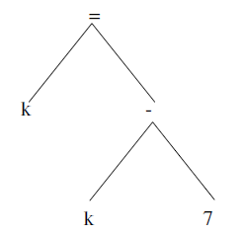
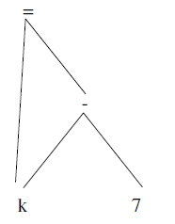
Advantages
Lends itself for machine independent code optimisation by code reorganisation
Disadvantages
Consumes lot of memory , so DAG can be used
k=k-7
AST
DAG

Slide 11
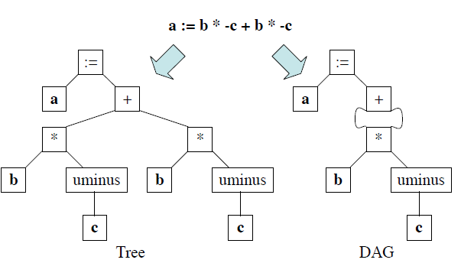

Slide 12
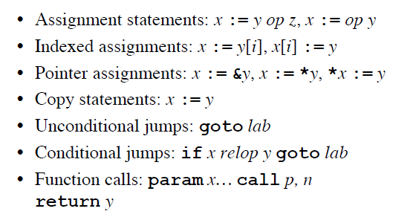
Three Address Code
A=B op C …. each statement consists of three addresses, two for the source operands (A and B ) and one for the result ( C ).
Unary: C: = op B

Slide 13
a := b * -c + b * -c
t1 := - c
t2 := b * t1
t3 := - c
t4 := b * t3
t5 := t2 + t4
a := t5
t1 := - c
t2 := b * t1
t3 := t2 + t2
a := t3
TAC for DAG
TAC for AST

Slide 14
i := 2 * n + k
while i do
i := i – k
t1 := 2
t2 := t1 * n
t3 := t2 + k
i := t3
L1: if i = 0 goto L2
t4 := i - k
i := t4
goto L1
L2:

Slide 15

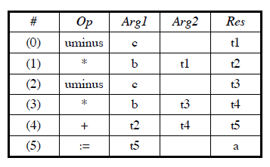
Implementation of TAC
Quadruples: A quadruple is a record with 4 fields. The fields are operator code, argument1, argument2 and the result
Pro: easy to rearrange code for global optimization
Cons: lots of temporaries
a := b * -c + b * -c
t1 := - c
t2 := b * t1
t3 := - c
t4 := b * t3
t5 := t2 + t4
a := t5

Slide 16
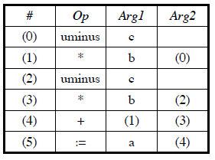
Triples
Record has three fields - operator code, argument1 and argument2.
Pro: temporaries are implicit
Cons: difficult to rearrange code
a := b * -c + b * -c
t1 := - c
t2 := b * t1
t3 := - c
t4 := b * t3
t5 := t2 + t4
a := t5

Slide 17
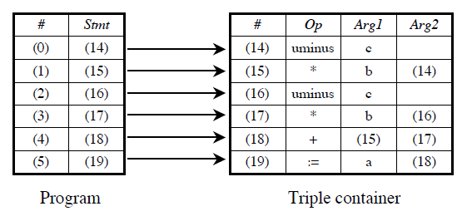
Indirect Triples
three address code, the listing consists of pointers to triples rather than the triples themselves
Pro: temporaries are implicit & easier to rearrange code
a := b * -c + b * -c

Slide 18
Comparison
Indirection – Quadruples (no); Triples (some extent) – best is indirect Triples
Suitability for optimisation – Quadruples (good); Triples (not good)
Space – Quadruples (more); Triples (least)

